Slide 1
US Road Safety: Analyzing Car Accidents for Predictive Insights
January 13, 2024
Rachel Chong

Slide 2
INTRODUCTION AND OVERVIEW
Problem Statement: How can we use machine learning to help address challenges in road safety, including identifying and mitigating car accident hotspots, providing real-time predictions, and analyzing causative factors for effective prevention and intervention?
Goal: By leveraging data science and machine learning, we aim to substantially reduce road safety accidents, contributing to a safer and more economically efficient society.
Notes:
Welcome to today's presentation where we embark on a journey to tackle the pressing issue of road safety in the United States through the lens of data science and machine learning.
Our focus lies in identifying accident hotspots, predicting real-time accidents, understanding causative factors, and evaluating the influence of environmental factors on accidents.
While the complete analysis is still underway, the initial findings and research serve as a crucial foundation for this capstone project.
This presentation sheds light on the diverse stakeholders impacted by road safety challenges, including commuters, law enforcement agencies, emergency services, city planners, and insurance companies.
Through the lens of data science, my goal is to provide insights that can lead to reduced accident risks for commuters, improved resource allocation strategies for law enforcement and emergency services, safer road design for city planners, and refined risk assessment models for insurance companies.

Slide 3
$340 Billion in 2019³
~19,937 crashes²
~118 deaths²
That’s a lot of money for traffic crashes
Each day
Each day
Notes:
According to CDC, Road traffic crashes are a leading cause of death in the United States for people ages 1–54.
According to the United States Department of Transportation, $340 billion in traffic crashes.

Slide 4
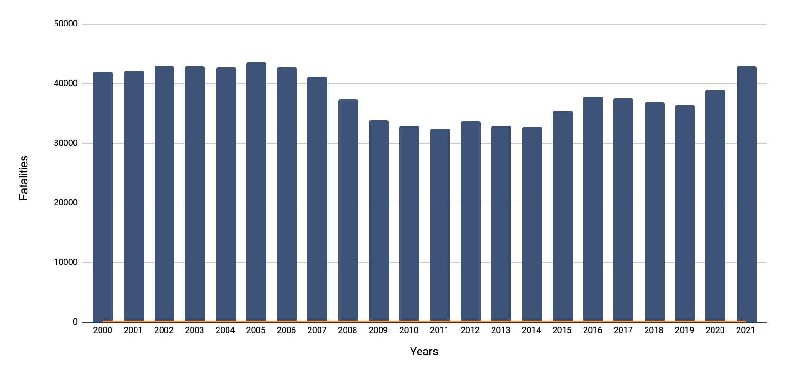
MOTOR VEHICLE SAFETY DATA
BUREAU OF TRANSPORTATION STATISTICS
Notes:
While dipping through most of the 2010's, the number of motor vehicle fatalities have unfortunately risen again in recent years.

Slide 5
BACKGROUND
Who is impacted?
Commuters, law enforcement agencies, emergency services, city planners, and insurance companies
Anticipated impact:
Enhance commuter safety
Optimized emergency responses
City planning for safer infrastructure
Insurance risk assessment improvement
Economic impact mitigation
Notes:
Who?
Commuters would benefit from reduced accident risks and improved travel times. Law enforcement and emergency services would gain insights for better resource allocation and response strategies. City planners could use the outcomes to design safer roads, and insurance companies could refine their risk assessment models.
Anticipated impact: project aims to benefit various stakeholders and improve overall road safety.
Personal Safety for Commuters:
Reduced accident risks directly benefit daily commuters, enhancing their personal safety during travel. By identifying and addressing accident hotspots, our project aims to create a safer environment for individuals on the road, ultimately minimizing the potential for injuries and fatalities.
Optimized Emergency Responses:
Law enforcement and emergency services stand to gain invaluable insights for better resource allocation and response strategies. Real-time accident prediction allows for optimized emergency services deployment, leading to quicker response times and more efficient assistance to those in need.
City Planning for Safer Infrastructure:
City planners can leverage the outcomes of this project to design safer roads and infrastructure. Understanding causative factors and accident patterns enables proactive planning measures, contributing to the creation of road networks that prioritize safety, reduce accidents, and enhance overall urban development.
Insurance Risk Assessment Improvement:
Insurance companies can refine their risk assessment models based on a more nuanced understanding of accident causation. This not only allows for more accurate premium calculations but also aids in developing policies that incentivize and reward safer driving practices.
Economic Impact Mitigation:
The societal and economic impact of accidents is significant, resulting in billions of dollars in costs annually. By accurately predicting accidents and implementing preventive measures, our project aims to mitigate these economic losses, fostering a more resilient and economically stable transportation system.

Slide 6
DATASET OVERVIEW
Kaggle Dataset: comprehensive dataset of car accidents across the USA spanning from February 2016 to March 2023
7.7 million rows x 46 columns
Accident severity, timestamps, geographical coordinates, weather conditions, and various Points of Interest annotations
Notes:
Points of interest (POIs) in the context of road safety refer to locations or features along a road that are noteworthy or significant for ensuring the safety of drivers, pedestrians, and other road users.

Slide 7
EDA AND DATA PREPROCESSING
Out of the 45 columns, 22 columns had null values
End latitude, end longitude, precipitation, wind chill, and wind speed were the top 5 columns with most null values
Data types include: bool(13), float64(12), int64(1), object(20)
No duplicate rows
Columns | Null Values
End_Lat | 3402762
End_Lng | 3402762
Precipitation(in) | 2203586
Wind_Chill(F) | 1999019
Wind_Speed(mph) | 571233
Visibility(mi) | 177098
Wind_Direction | 175206
Humidity(%) | 174144
Weather_Condition | 173459
Temperature(F) | 163853
Pressure(in) | 140679
Weather_Timestamp | 120228
Sunrise_Sunset | 23246
Civil_Twilight | 23246
Nautical_Twilight | 23246
Astronomical_Twilight | 23246
Airport_Code | 22635
Street | 10869
Timezone | 7808
Zipcode | 1915
City | 253
Description | 5

Slide 8
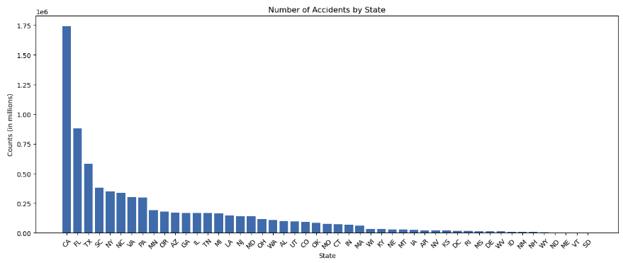
DATA EXPLORATION
NUMBER OF ACCIDENTS BY STATE

Slide 9
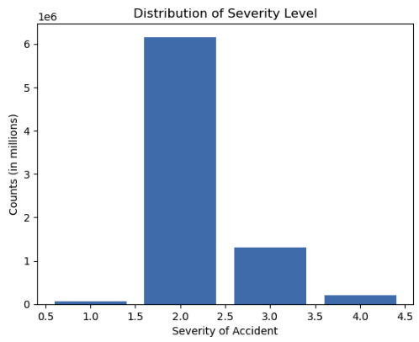
DATA EXPLORATION
DISTRIBUTION OF SEVERITY LEVEL
Severity of the accident on a scale of 1 to 4 where 1 indicates minimal impact and 4 significant

Slide 10
NEXT STEPS
Continue cleaning data and conduct a more granular EDA
Explore predictive modeling techniques such as binary classification and multi-class classification
Binary Classification: Develop a system to predict the likelihood of an accident in real-time based on current conditions such as traffic cameras, weather APIs, and road sensors
Multi-Class Classification: Predicting severity level of accidents based on various features such as location, time, weather conditions, road type, traffic density, driver behavior, and vehicle conditions

Slide 11
GENERAL REFERENCES
CDC. (2020, December 14). Road Traffic Injuries and Deaths—A Global Problem. Centers for Disease Control and Prevention. https://www.cdc.gov/injury/features/global-road-safety/index.html#:~:text=Road%20traffic%20crashes%20are%20a
How Many Car Accidents Occur Each Hour, Day & Year? (n.d.). Https://Amarolawfirm.com/. Retrieved January 11, 2024, from https://amarolawfirm.com/how-many-car-accidents-occur-each-hour-day-year-in-the-u-s/#
NHTSA: Traffic Crashes Cost America $340 Billion in 2019 | NHTSA. (2023, January 10). Www.nhtsa.gov. https://www.nhtsa.gov/press-releases/traffic-crashes-cost-america-billions-2019

Slide 12
DATASET REFERENCES
Moosavi, Sobhan, Mohammad Hossein Samavatian, Srinivasan Parthasarathy, and Rajiv Ramnath. “A Countrywide Traffic Accident Dataset.”, 2019.
Moosavi, Sobhan, Mohammad Hossein Samavatian, Srinivasan Parthasarathy, Radu Teodorescu, and Rajiv Ramnath. "Accident Risk Prediction based on Heterogeneous Sparse Data: New Dataset and Insights." In proceedings of the 27th ACM SIGSPATIAL International Conference on Advances in Geographic Information Systems, ACM, 2019.

Slide 13
THANK YOU!
Any questions?

